Slide 1

ERROR HANDLING
C3: Protected

Slide 2

About the Author
Created By: | Sucharita Das (241163) & Rajalaxmi (301159)
Credential Information: | 8+ years of SQL Server developer/architect experience
Version and Date: | SS2008/0611/1.0
Cognizant Certified Official Curriculum

Slide 3









Icons Used
Hands on Exercise
Questions
Tools
Coding Standards
Test Your Understanding
Reference
A Welcome Break
Contacts
Demonstration

Slide 4
ERROR HANDLING Overview
  INTRODUCTION
  SCENARIOS
  @@ERROR.
  TRY..CATCH BLOCK
  USER DEFINED ERROR MESSAGE
  THROW Vs RAISERROR
  ERRORS UNHANDLED BY TRY..CATCH BLOCK and SOLUTION

Slide 5
Objectives
Objective:
After completing this chapter you will be able to:
  Implement Error Handling using @@ERROR and TRY..CATCH block.
  Handle the errors using RAISERROR and THROW.

Slide 6
INTRODUCTION
The ability to handle errors is essential in any programming language and, naturally, we have to implement safe error handling in our T-SQL if we want to build solid SQL Server code.
When an unexpected error occurs during data modification, it is essential that execution of the statement is terminated, the database is returned to the state it was in before the statement started. Error Handling helps in implementing this feature.

Slide 7
ERROR HANDLING SCENARIOS
Possible scenarios where we can use error handling:
While executing some DML Statement like INSERT, DELETE, UPDATE .
If transaction fails, then we need to rollback .
While using Cursor .

Slide 8
Error Handling Mechanism
The two most common mechanisms for error handling in SQL Server are:
@@ERROR
TRY-CATCH Block

Slide 9
Using @@ERROR
@@Error is a Global Variable in SQL Server.
Returns the error number for the last Transact-SQL statement executed.
But the catch here is , we have to trace it just after the next line where the actual error occurred, otherwise, it will reset to 0.
Returns 0 if no error was generated.

Slide 10
Using @@ERROR
SYNTAX :
Select @@ERROR
RETURN TYPE :
int
@@ERROR contains the value from the sys.messages.message_id column for that error.
We can view the text associated with an @@ERROR error number in sys.messages.

Slide 11
Using @@ERROR
select 1/0
select @@ERROR
RESULT :
No Column Name
-----------------------
8134
Msg 8134, Level 16, State 1, Line 2
Divide by zero error encountered.
(1 row(s) affected)

Slide 12
When Should We Use @@Error
There are some scenarios where we should use @@ERROR:
With Insert, Delete, Update, Select Into Statement.
While using Cursor in SQL Server (Open, Fetch Cursor).
While executing any Stored Procedure.

Slide 13
TRY...CATCH (Transact-SQL)
Implements error handling for Transact-SQL that is similar to the exception handling .
This feature is available from SQL Server 2005 onwards.
A group of Transact-SQL statements can be enclosed in a TRY block .
If an error occurs in the TRY block , control is passed to CATCH block

Slide 14
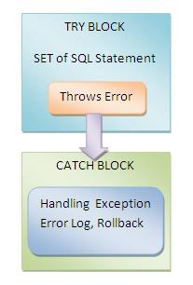
TRY...CATCH (Transact-SQL)

Slide 15
TRY...CATCH (Transact-SQL)
SYNTAX :
BEGIN TRY
{ sql_statement | statement_block }
END TRY
BEGIN CATCH
[ { sql_statement | statement_block } ]
END CATCH
[ ; ]
A TRY…CATCH construct catches all execution errors that have a severity higher than 10 that do not close the database connection.

Slide 16
TRY...CATCH (Transact-SQL)
create table StudentDetails
(
roll_no int, name varchar(30), address varchar(30)
)
BEGIN TRY
INSERT INTO StudentDetails(roll_no, name)
VALUES('a', ‘Roger')
END TRY
BEGIN CATCH
SELECT 'There was an error while Inserting records in DB '
END CATCH

Slide 17
TRY...CATCH (Transact-SQL)
A TRY…CATCH construct cannot
a) span multiple batches.
b) span multiple blocks of Transact-SQL statements.
c) be used with user-defined functions.

Slide 18
TRY...CATCH (Transact-SQL)
Errors trapped by a CATCH block are not returned to the calling application.
To do so ,we have to use any of the following :
i) SELECT result sets
ii) RAISERROR
iii) PRINT statements.
To get the details of the error SQL Server provides the System functions that we can use for retrieving the details of the error.

Slide 19
TRY...CATCH EXAMPLE
BEGIN TRY
SELECT 5/0
END TRY
BEGIN CATCH
SELECT
ERROR_NUMBER() AS ErrNumber,
ERROR_SEVERITY() AS ErrSeverity,
ERROR_STATE() AS ErrState,
ERROR_PROCEDURE() AS ErrProc,
ERROR_LINE() AS ErrLine,
ERROR_MESSAGE() AS ErrMessage
END CATCH

Slide 20
TRY...CATCH ( OUTPUT)
ErrNumber | 8134
ErrSeverity | 16
ErrState | 1
ErrProc | NULL
ErrLine | 2
ErrMessage | Divide by zero error encountered.

Slide 21
TRY...CATCH (Transact-SQL)
ERROR_NUMBER() returns the number of the error.
ERROR_SEVERITY() returns the severity.
ERROR_STATE() returns the error state number.
ERROR_PROCEDURE() returns the name of the stored procedure or trigger where the error occurred.
ERROR_LINE() returns the line number inside the routine that caused the error.
ERROR_MESSAGE() returns the complete text of the error message. The text includes the values supplied for any substitutable parameters, such as lengths, object names, or times.

Slide 22
ERROR FUNCTIONS
These functions return NULL if they are called outside the scope of the CATCH block.
These functions returns error occurred regardless of the number of times it is called or where it is called within the scope of the CATCH block.
Hence these are better and more flexible than, @@ERROR (sounds familiar ??)

Slide 23
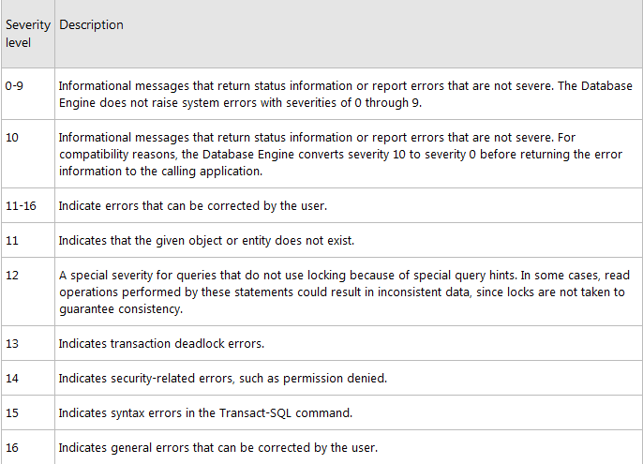
ERROR_SEVERITY()

Slide 24
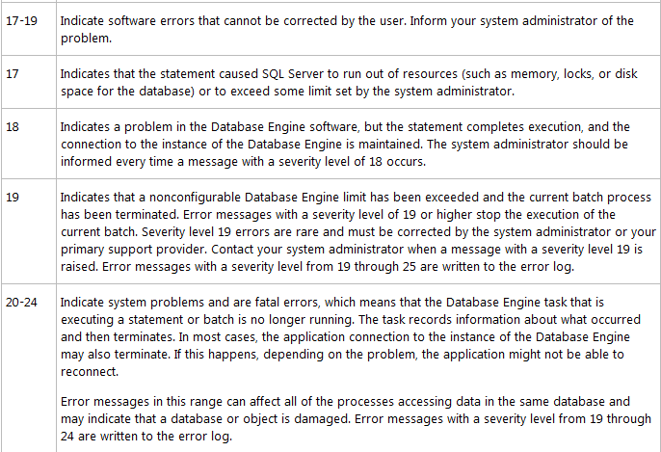
ERROR_SEVERITY()

Slide 25
User-Defined Error Message Severity
sp_addmessage can be used to add user-defined error messages with severities from 1 through 25 to thesys.messages catalog view
user-defined error messages can be used by RAISERROR .
SYNTAX :
sp_addmessage [ @msgnum= ] msg_id , [ @severity= ] severity , [ @msgtext= ] 'msg' [ , [ @lang= ] 'language' ] [ , [ @with_log= ] { 'TRUE' | 'FALSE' } ] [ , [ @replace= ] 'replace' ]

Slide 26
User-Defined Error Message Severity
[ @msgnum= ] msg_id → integer between 50,001 and 2,147,483,647 .
[ @severity = ]severity →smallint with a default of NULL.
[ @msgtext = ] 'msg' → nvarchar(255) with a default of NULL.
[ @lang = ] 'language' →Is the language for this message.
[ @with_log = ] { 'TRUE' | 'FALSE' } → varchar(5) with a default of FALSE.
[ @replace = ] 'replace' →varchar(7) with a default of NULL.

Slide 27
RAISERROR
RAISERROR can be used in either the TRY or CATCH block of a TRY..CATCH construct to affect error-handling behavior.
RAISERROR can be used to return information to the caller about the error that caused the CATCH block to execute.
The severity must be set to a value between 11 and 19.
RAISERROR that has a severity 10 or lower returns an informational message to the calling batch or application without invoking a CATCH block.

Slide 28
RAISERROR
SYNTAX :
RAISERROR ( { msg_id | msg_str | @local_variable } { ,severity ,state } [ ,argument [ ,...n ] ] ) [ WITH option [ ,...n ] ]
msg_str
  Is a user-defined message with formatting similar to the printf function in the C standard library.

Slide 29
EXAMPLE
BEGIN TRY
RAISERROR('This error was raised in the try block',12,1)
END TRY
BEGIN CATCH
SELECT
ERROR_NUMBER() AS ErrNumber,
ERROR_SEVERITY() AS ErrSeverity,
ERROR_STATE() AS ErrState,
ERROR_PROCEDURE() AS ErrProc,
ERROR_LINE() AS ErrLine,
ERROR_MESSAGE() AS ErrMessage
END CATCH

Slide 30
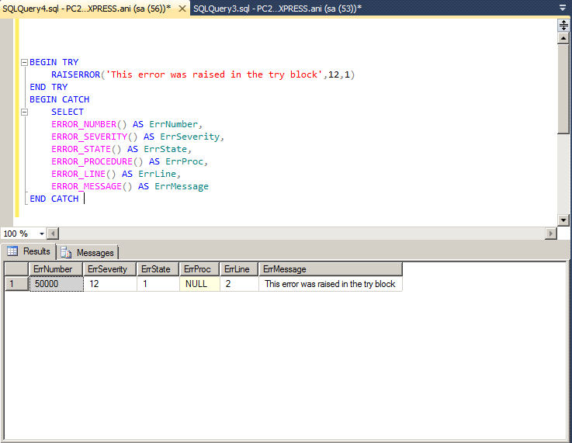
OUTPUT

Slide 31
THROW (Transact-SQL)
Raises an exception and transfers execution to a CATCH block of a TRY…CATCH construct in SQL Server 2012 .
THROW [ { error_number | @local_variable },
{ message | @local_variable },
{ state | @local_variable } ]
[ ; ]
If a TRY…CATCH construct is not available, the session is ended. The line number and procedure where the exception is raised are set. The severity is set to 16.

Slide 32
EXAMPLE
THROW 51000, 'The record does not exist.', 1;
CREATE TABLE TestRethrow
( ID INT PRIMARY KEY );
BEGIN TRY
INSERT into TestRethrow(ID) VALUES(1);
INSERT into TestRethrow(ID) VALUES(1)
END TRY
BEGIN CATCH
PRINT 'In catch block.';
THROW;
END CATCH

Slide 33
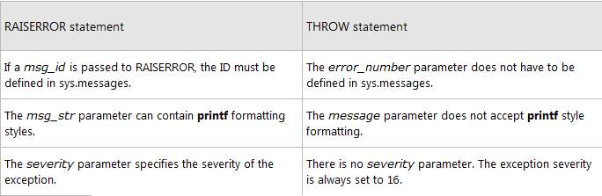
DIFFERENCES BETWEEN RAISERROR AND THROW

Slide 34
Errors Unaffected by a TRY…CATCH Construct
TRY…CATCH constructs do not trap the following conditions:
Warnings or informational messages that have a severity of 10 or lower.
Errors that have a severity of 20 or higher that stop the SQL Server Database Engine task processing for the session.
Attentions, such as client-interrupt requests or broken client connections.
When the session is ended by a system administrator by using the KILL statement.

Slide 35
Errors Unhandled by a TRY…CATCH Construct
Compile errors, such as syntax errors, that prevent a batch from running.
Errors that occur during statement-level recompilation, such as object name resolution errors that occur after compilation because of deferred name resolution.

Slide 36
Errors Unhandled by a TRY…CATCH Construct
EXAMPLE OF SYNTAX ERROR
BEGIN TRY
-- This PRINT statement will not run because the batch
-- does not begin execution.
PRINT N'Starting execution';
-- This SELECT statement contains a syntax error that
-- stops the batch from compiling successfully.
SELECT ** FROM HumanResources.Employee;
END TRY
BEGIN CATCH
SELECT
ERROR_NUMBER() AS ErrorNumber,
ERROR_MESSAGE() AS ErrorMessage;
END CATCH;

Slide 37
Errors Unhandled by a TRY…CATCH Construct
EXAMPLE OF OBJECT NAME RESOLUTION ERROR
BEGIN TRY
-- This PRINT statement will run because the error
-- occurs at the SELECT statement.
PRINT N'Starting execution';
-- This SELECT statement will generate an object name
-- resolution error because the table does not exist.
SELECT * FROM NonExistentTable;
END TRY
BEGIN CATCH
SELECT
ERROR_NUMBER() AS ErrorNumber,
ERROR_MESSAGE() AS ErrorMessage;
END CATCH;

Slide 38
SOLUTION
Placing the code in a stored procedure or by executing a dynamic Transact-SQL.
CREATE PROCEDURE usp_MyError
AS
SELECT * FROM NonExistentTable;
BEGIN TRY
EXECUTE usp_MyError;
END TRY
BEGIN CATCH
SELECT
ERROR_NUMBER() AS ErrorNumber,
ERROR_MESSAGE() AS ErrorMessage;
END CATCH;

Slide 39
Test Your Understanding
What will be the value of @@ERROR when it is executed twice
What are the major error handling mechanisms in SQL Server ?
Mention the differences between THROW and RAISERROR.
What are the errors unhandled by TRY..CATCH block ?

Slide 40
Test Your Understanding
PREDICT OUTPUT :
BEGIN TRY
SELECT 1
UNION ALL
SELECT 2
UNION ALL
SELECT NULL
END TRY
SELECT * FROM StudentDetails
BEGIN CATCH
PRINT ‘ ERROR !!’
END CATCH

Slide 41
Test Your Understanding
OUTPUT :
SYNTAX ERROR !!!
REASON :
Including any other statements between the END TRY and BEGIN CATCH statements generates a syntax error.

Slide 42
SQL Server Error Handling: Summary
SQL Server uses the @@ERROR and TRY..CATCH block for error handling.
System provided error functions
  ERROR_NUMBER(),ERROR_SEVERITY(),ERROR_STATE(),ERROR_PROCEDURE(),ERROR_MESSAGE().
To return an error caught by catch block ,back to the application use
  SELECT
  RAISERROR,
  PRINT STATEMENTS
Syntax errors and object name resolution errors are unhandled by TRY..CATCH block. To catch the error ,place the code in a stored procedure or run it as dynamic SQL.

Slide 43
ERROR HANDLING: Source
MSDN website
Disclaimer: Parts of the content of this course is based on the materials available from the Web sites and books listed above. The materials that can be accessed from linked sites are not maintained by Cognizant Academy and we are not responsible for the contents thereof. All trademarks, service marks, and trade names in this course are the marks of the respective owner(s).

Slide 44

You have successfully completed
SQL Server 2008 Error Handling

